Slide 1


CHRISTIAN COLLEGE OF ENGINEERING AND TECHNOLOGY, BHILAI
3rd International Conference on Innovations in Science, Hybrid System and Various Technological Advances (IC-ISHVA 2025)
16th and 17th December 2025
EV vs ICE Market Share in India: A Segment-Wise Comparative Analysis
(2021–2025)
Paper Id: 003_Khot_IC-ISHVA2025
Author’s name: Prof.Deepika Sarvate, Poonam khot, Shravani Yelbhar, Manisha Kadam
Presented by: Poonam Anil Khot, MCA Department
JSPM Narhe Technical Campus
SPPU, Pune, India.

Slide 2
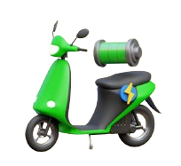

Introduction
  India’s EV adoption has accelerated since 2021
  Growth is driven by government subsidies, TCO benefits, and technological improvements
  Rapid expansion in 2W and 3W EV segments
  4W EV adoption remains slow but emerging
  This study compares EV vs ICE market share trends from 2021–2025

Slide 3





Research Question
How have EV market shares evolved compared to ICE vehicles in 2W, 3W, and 4W segments in India between 2021–2025?

Slide 4

Research Gap
Research Gap
  No unified EV vs ICE market share dataset
  Inconsistent denominators (registrations vs retail vs wholesale)
  Limited multi-year segment-wise comparative studies
  Lack of structural break & policy-linked analysis

Slide 5


Objectives
  Calculate year-wise EV market shares (2W, 3W, 4W) from 2021–2025
  Compare EV vs ICE adoption trends
  Identify factors affecting EV growth
  Detect structural breaks linked to policy changes
  Provide policy-level recommendations

Slide 6
Research Methodology
  Design: Quantitative, longitudinal
  Data Sources:
    Vahan (MoRTH)
    FADA retail reports
    SIAM industry statistics
    NITI Aayog, JMK Research, IEA
  Steps:
    Monthly → Annual aggregation
    EV Units / Total Units × 100
  Tools: Excel, Python, Power BI

Slide 7
Market Share Table (2021–2025)
Market Share Table (2021–2025)
Year | 2W EV Share (%) | 3W EV Share (%) | 4W EV Share (%)
2021 | 1.2% | 15.0% | 2.5%
2022 | 3.2% | 28.0% | 4.8%
2023 | 5.1% | 54.7% | 8.0%
2024 | 6.1% | 70.0% | 4.0%
2025* (till May) | 6.1% | 33.0% | 4.1%

Slide 8


2W Market Analysis
  Share increased from 1.2% → 6.1%
  Driven by:
    Affordable models
    Low running cost
    State subsidies
  High potential due to daily commute demand

Slide 9
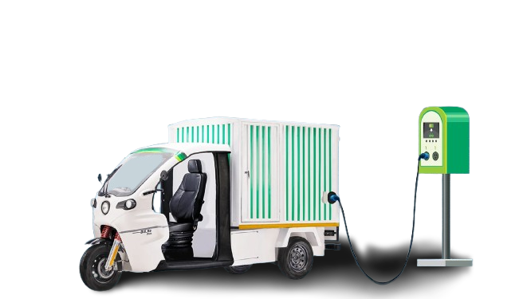
3W Market Analysis
  Largest EV adoption in India
  EV share grew from 15% → 70%
  Reasons:
    High vehicle utilization
    Strong TCO advantage
    E-commerce & last-mile delivery boom

Slide 10
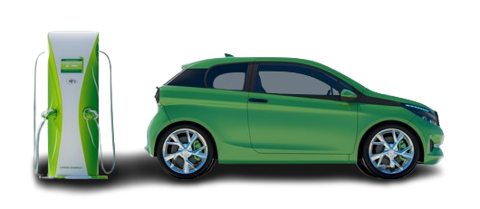
4W Market Analysis
  Slow adoption: 2.5% → 4%
  Barriers:
    High upfront cost
    Limited charging infrastructure
    Range anxiety
  Growth mostly fleet-driven (Uber, BluSmart)

Slide 11
Conclusion
  India’s EV transition is strong but uneven
  3W → fastest adoption
  2W → rising rapidly,Growing
  4W → slow, premium segment challenges
  Policy stability & charging infra expansion are key

Slide 12
Recommendations
Focus on segments: Support 3W EVs with continued incentives; improve financing and incentives for 4W buyers.
Improve charging infrastructure: Expand urban charging for 2W/3W and fast-charging corridors for 4W.
Better data availability: Publish standardised monthly EV sales data for research and policy planning.
Encourage advanced research: Use impact analysis and forecasting models to evaluate EV policies.

Slide 13
References
Ministry of Road Transport & Highways (MoRTH) – Vahan Dashboard: Vehicle registration data
Federation of Automobile Dealers Associations (FADA) – Monthly vehicle retail data
Society of Indian Automobile Manufacturers (SIAM) – Statistics and publications
NITI Aayog (2025) – India Electric Mobility Index 2024
EV reporter (2025) – India EV sales and segment analysis
JMK Research (2024–2025) – EV penetration and segment reports
International Energy Agency (IEA) – Global EV Outlook 2024

Slide 14

Thank You !!!

